Slide 1

Advanced x86: BIOS and System Management Mode Internals More Fun with SMM
Xeno Kovah && Corey Kallenberg
LegbaCore, LLC

Slide 2
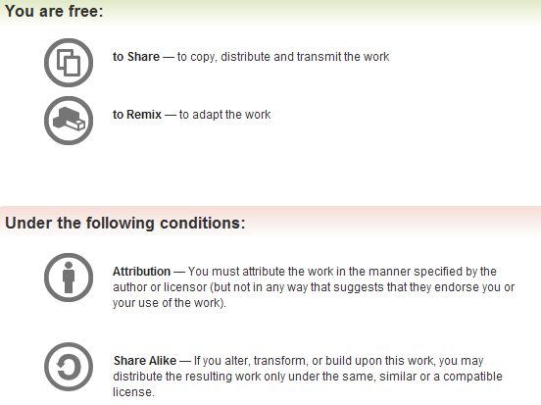
All materials are licensed under a Creative Commons “Share Alike” license.
http://creativecommons.org/licenses/by-sa/3.0/
Attribution condition: You must indicate that derivative work
"Is derived from John Butterworth & Xeno Kovah’s ’Advanced Intel x86: BIOS and SMM’ class posted at http://opensecuritytraining.info/IntroBIOS.html”
Notes:
Attribution condition: You must indicate that derivative work
"Is derived from John Butterworth & Xeno Kovah’s ’Advanced Intel x86: BIOS and SMM’ class posted at http://opensecuritytraining.info/IntroBIOS.html”

Slide 3
Other ways to break into SMM

Slide 4
Ways to break into SMM so far
Break into the SPI flash chip, because it sets up the contents of SMRAM
Get lucky and find out that the vendor didn’t set D_LCK
Be on a system that’s too old to support SMRR (auto-win)
Be on a system where the vendor didn’t set the SMRR
Other?
Notes:
***This is not going to be a discussion on CPU architecture, for details on caching I recommend 3 sources:
Both the Intel and AMD Optimization Reference Manuals, and Agner Fog’s optimization references

Slide 5
Q35 chipset remapping bug
There is a remapping feature present in chipsets that allows them to remap and reclaim space “lost” to the PCI Memory Mapped IO region of the memory map
It turned out you could also use that bug to remap the protected SMRAM into non-protected space!
Then it was a simple matter to read and write it

Slide 6
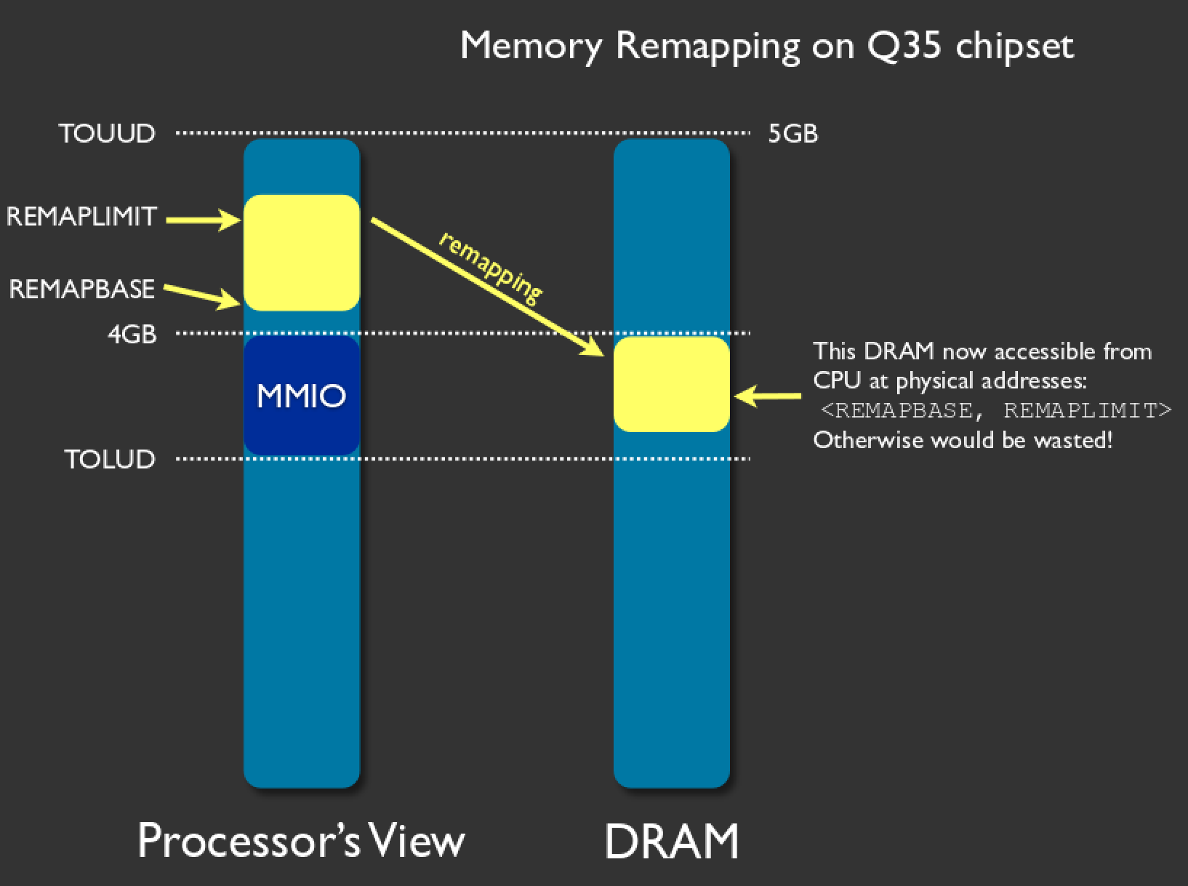
http://invisiblethingslab.com/resources/bh09dc/Attacking%20Intel%20TXT%20-%20slides.pdf

Slide 7
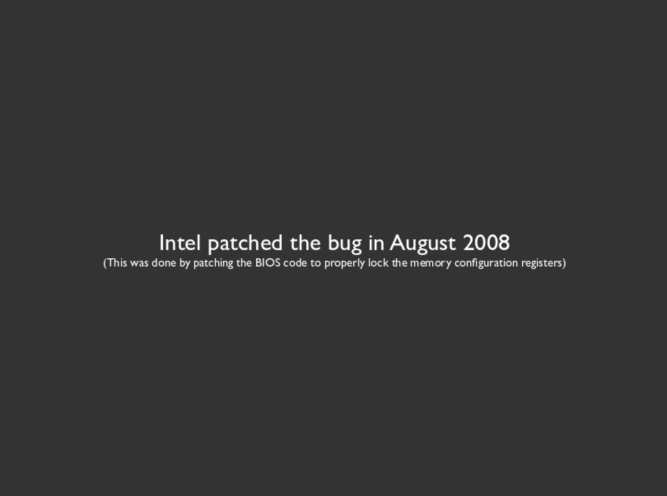
http://invisiblethingslab.com/resources/bh09dc/Attacking%20Intel%20TXT%20-%20slides.pdf
Xeno note:
This implies that other BIOSes could be vulnerable, if they’re not setting the configuration correctly.
We never got around to re-investigating this, and therefore it’s not a Copernicus built in check.
It could be that similar issues are lurking in deployed BIOSes.

Slide 8
What if…
What if the SMI handler code was poorly written, and it basically reached out and grabbed resources outside of its protected SMRAM area?
What if it executed code completely outside of its protected area?!

Slide 9
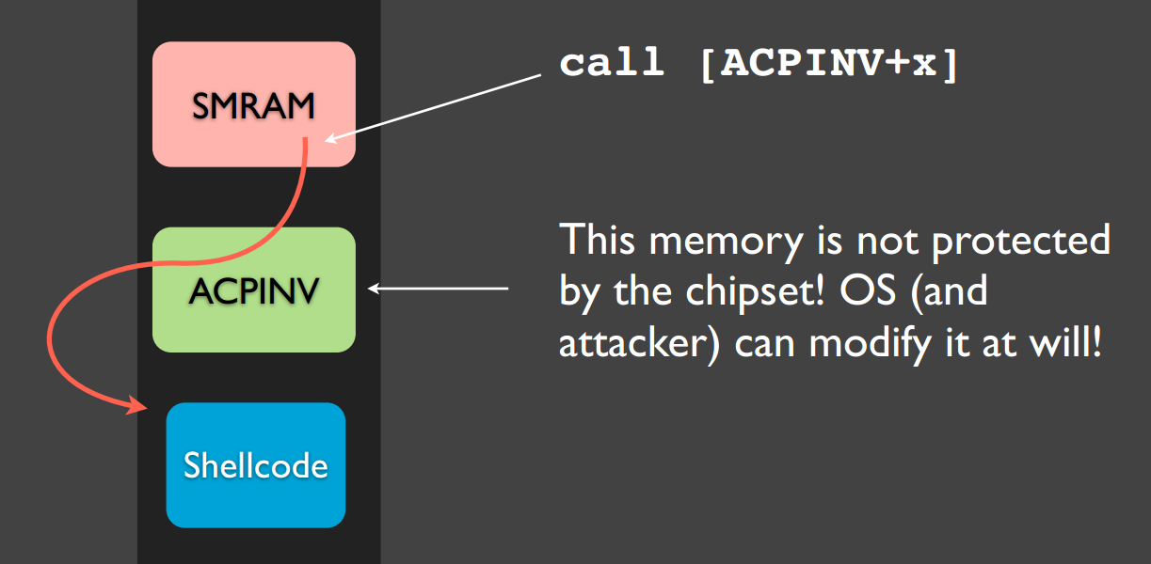
ITL Attack
Untrusted ACPI function pointer called by SMM led to easily exploitable vulnerability
https://www.blackhat.com/presentations/bh-usa-09/WOJTCZUK/BHUSA09-Wojtczuk-AtkIntelBios-SLIDES.pdf

Slide 10
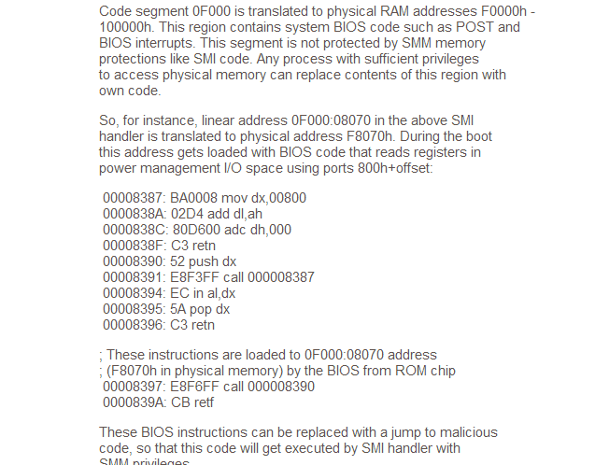
“ASUS Eee PC and other series: BIOS SMM privilege escalation vulnerabilities” by core collapse
Numerous instances of untrusted code execution by SMM in OEM firmware
Probably lots more of these in proprietary SMM modules
http://archives.neohapsis.com/archives/bugtraq/2009-08/0059.html

Slide 11

NOT-SMM
SMM

Slide 12
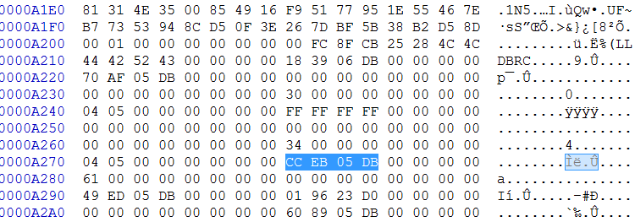
We did a little RE work to determine which SMM code we could invoke from the OS by writing to port 0xB2
In this case, function 0xDB05EDCC within SMM can be reached by writing 0x61 to port 0xB2
Almost every UEFI system we surveyed used this format to record reachable SMM code

Slide 13
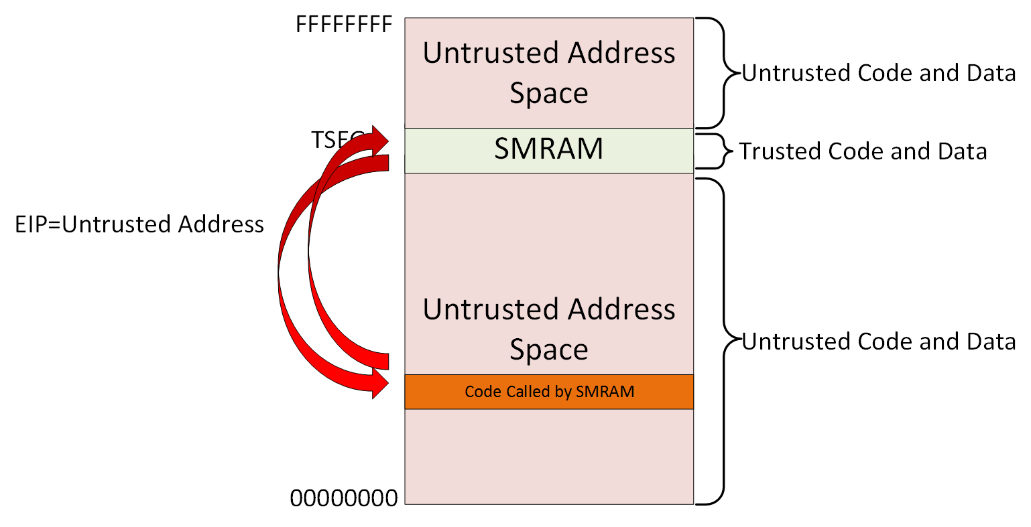
We found a lot of these vulnerabilities
They were so easy to find, we could write a ~300 line IDAPython script that found so many I stopped counting and (some) vendors stopped emailing me back

Slide 14
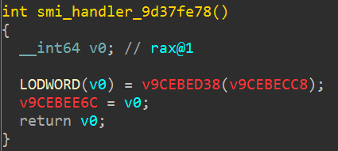

Slide 16
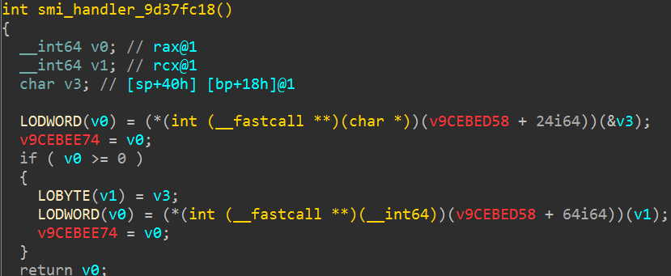

Slide 18
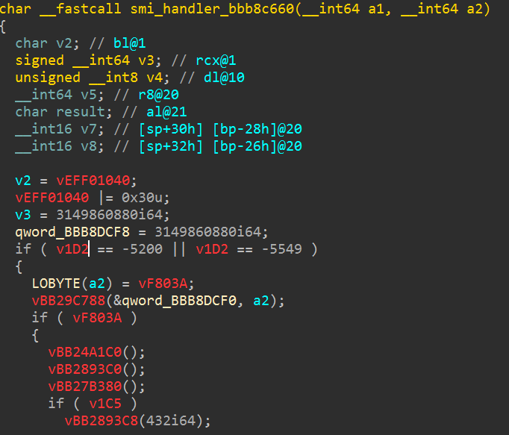
Seriously HP?

Slide 19
ACPI remapping attack
“Memory sinkhole attack” by Domas at BlackHat 2015
Fixed in Sandy Bridge (2nd generation Core I series) & Atom 2013 processors
Vulnerable on older

Slide 20
TODO: Intel SMRAM overlap bugs

Slide 21
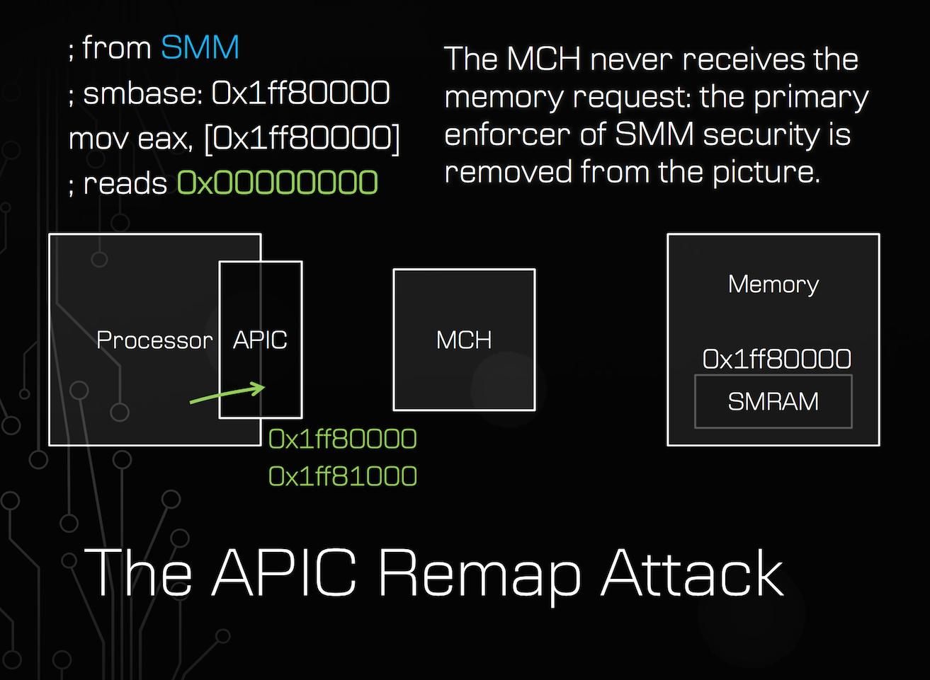

Slide 22
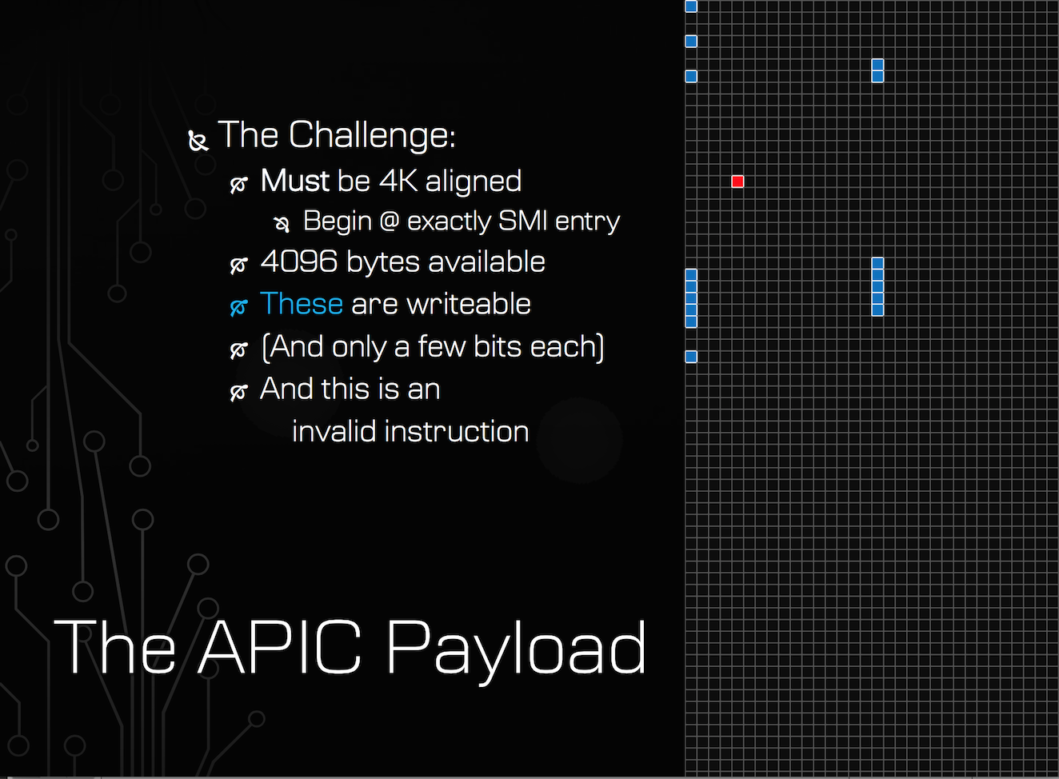

Slide 23
“Unpatchable”?
Domas claimed that it’s unpatchable
It can be patched by making the SMI handler entry point check if the APIC is mapped overlapping SMRAM, and then setting it back to the typical default address (either temporarily or permanently.)
Yes, that breaks the “feature” of being able to relocate the APIC, but it’s highly unlikely anyone’s using it anyway, and if they were, technically they should be reading the current location anyway

Slide 24
Other things to do from SMM

Slide 25
Defeat Intel TXT
Intel added new CPU instructions (“Safer Mode Extensions” in the manual, “Trusted Execution Technology” (TXT) for marketing) that try to make the system more secure
The basic idea of TXT is to tear down your existing computing environment and build it back up from a secure starting point, so that you can trust whatever runs next

Slide 26
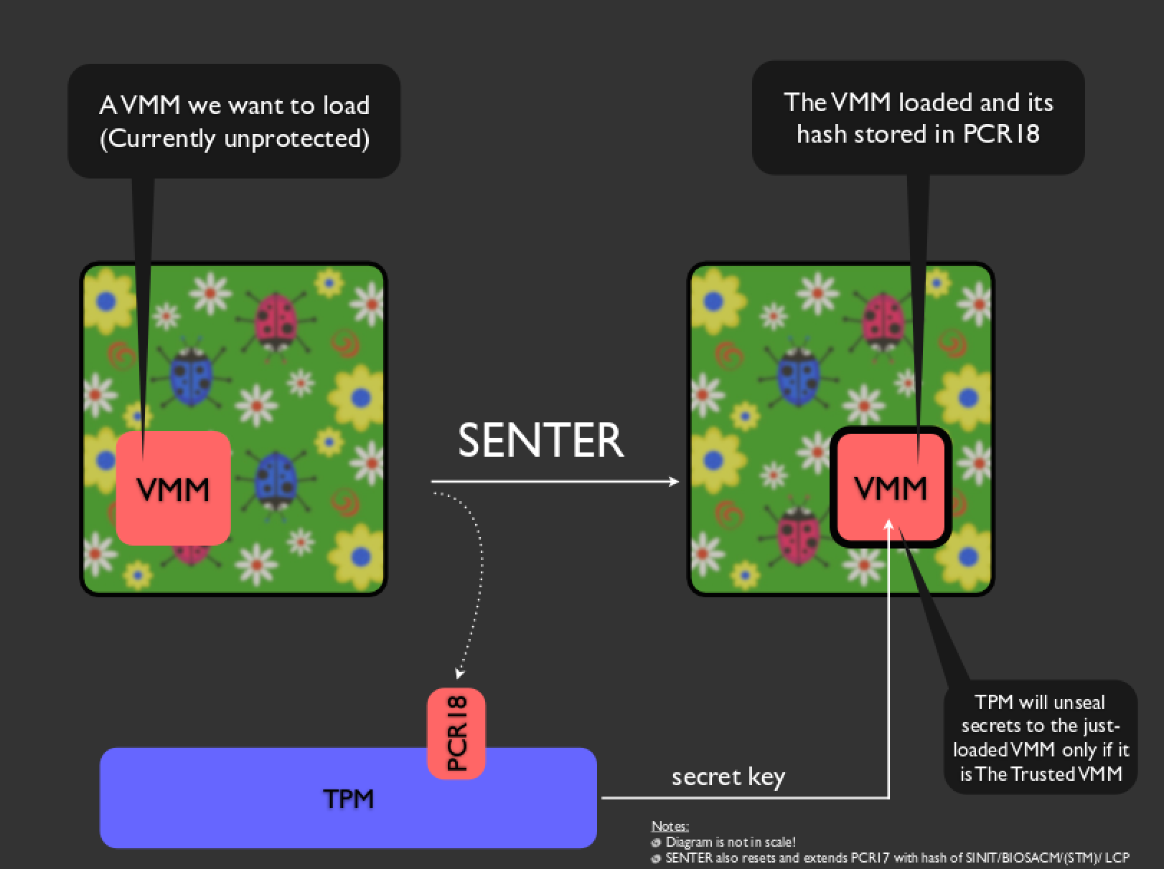
http://invisiblethingslab.com/resources/bh09dc/Attacking%20Intel%20TXT%20-%20slides.pdf

Slide 27
Defeat Intel TXT
Unfortunately TXT does not measure SMRAM, and thus an attacker who has already broken into SMRAM can remain un-measured

Slide 28
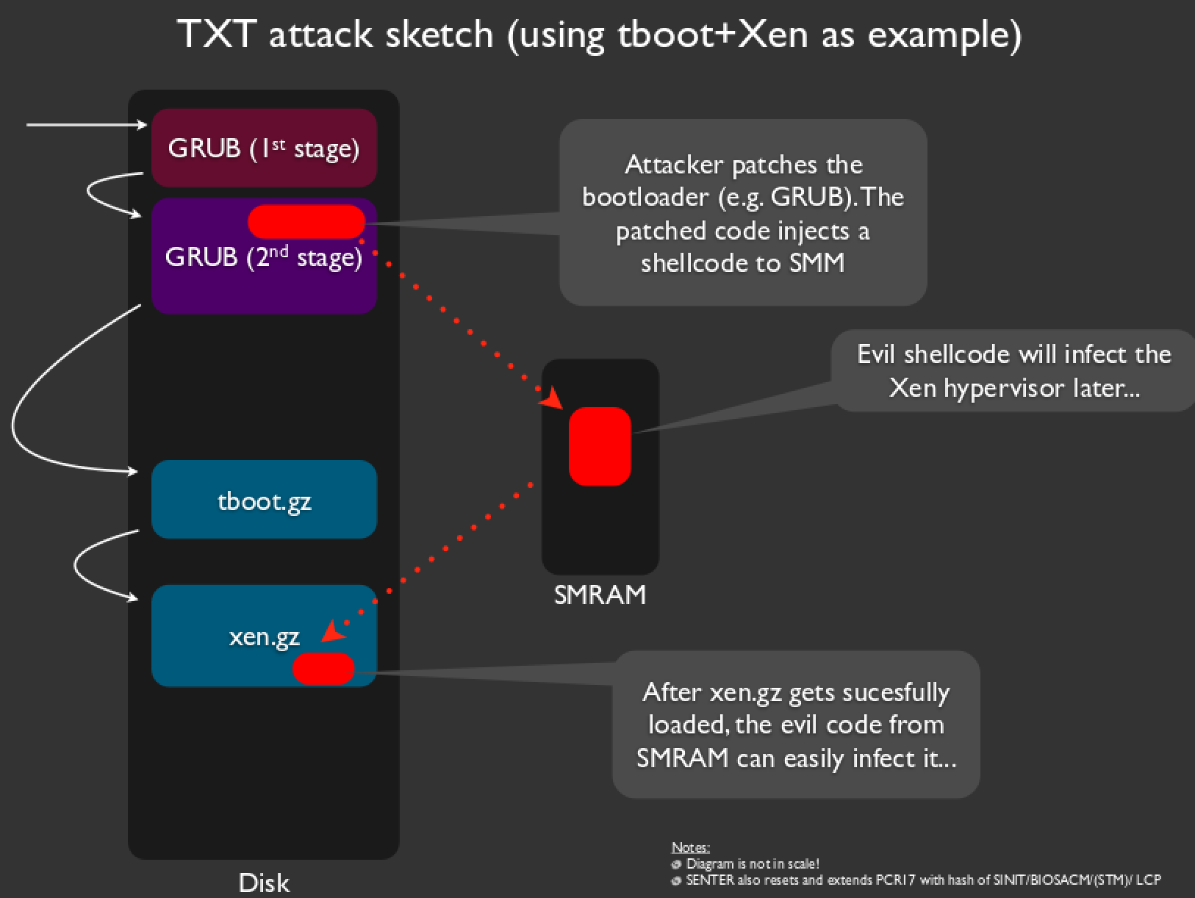
http://invisiblethingslab.com/resources/bh09dc/Attacking%20Intel%20TXT%20-%20slides.pdf

Slide 29
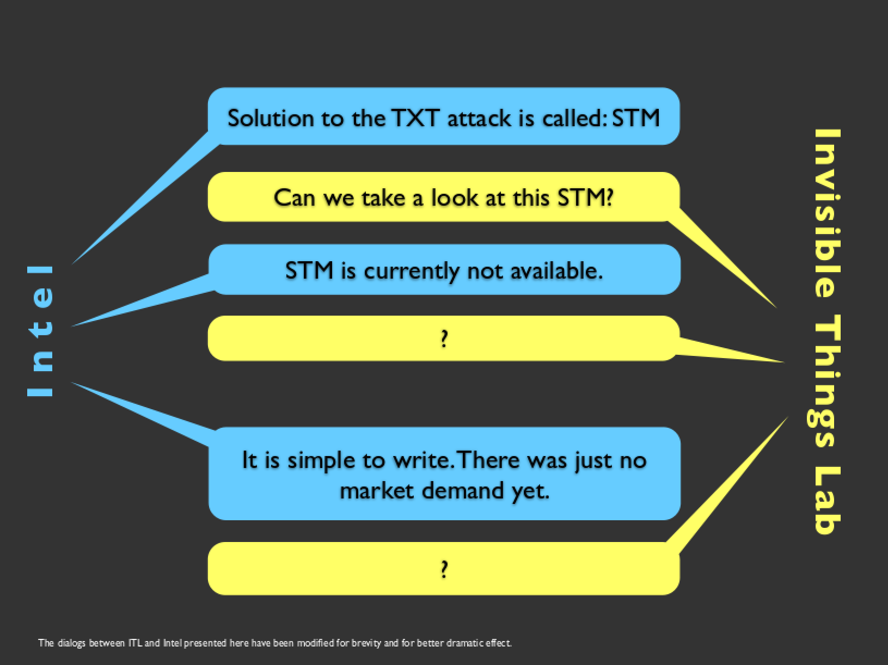
http://invisiblethingslab.com/resources/bh09dc/Attacking%20Intel%20TXT%20-%20slides.pdf

Slide 30
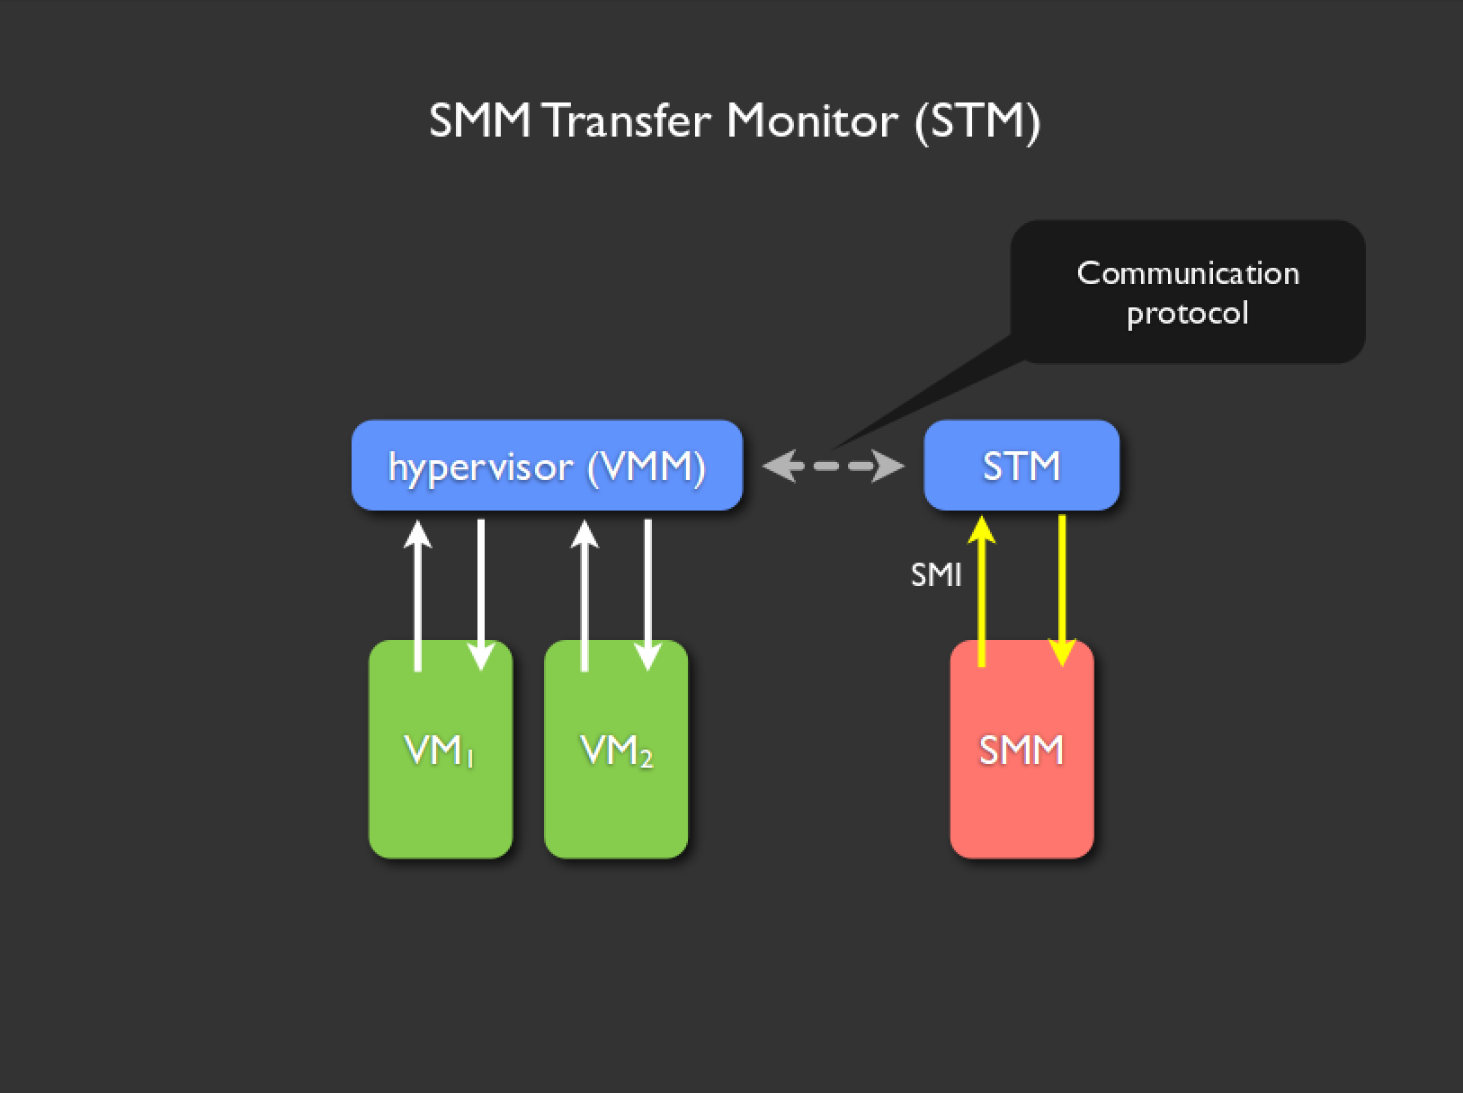
Ring -1
Ring -2.25 ;)
Ring 0
Ring -2

Slide 31
So IF you had an STM
Then you could place it in a portion of SMRAM called MSEG (“measured segment”), and when you do a TXT launch, you would get a measurement of whether your special SMM-jailing-hypervisor (STM) is intact or not.
And then that STM would need to be the main entry point to SMM so that it could run before any potentially malicious code

Slide 32
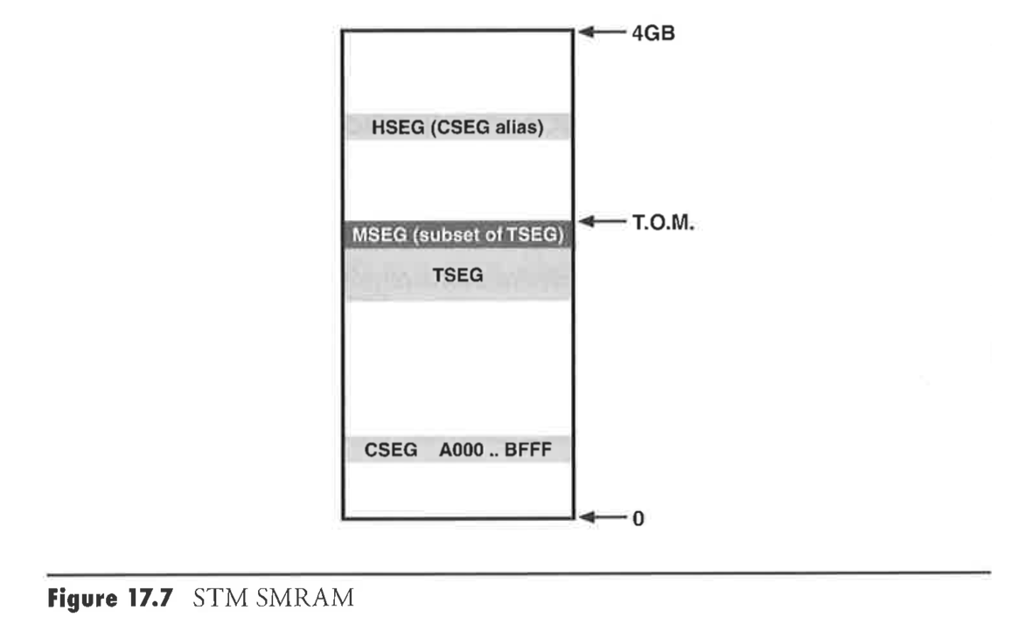

Slide 33
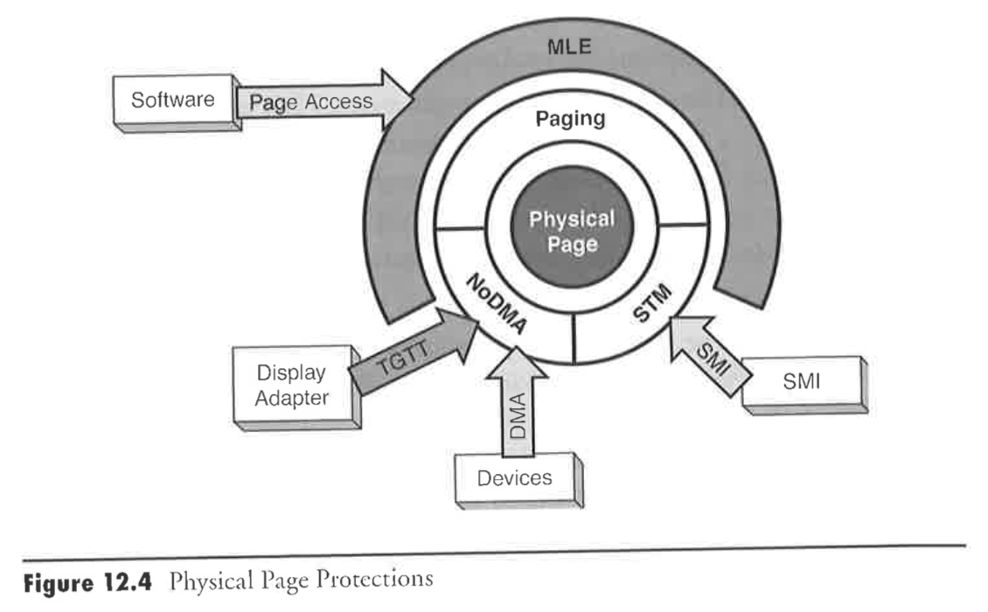
Building an STM is one of LegbaCore’s core business goals – because we’re all architecturally vulnerable until that happens
But you have to tell your OEM that you want to *not* be vulnerable, otherwise they won’t deploy it
DOESN’T EXIST ON MOST SYSTEMS!
GAPING HOLE!
From Intel Press “Dynamics of a Trusted Platform” - Grawrock

Slide 34
Late-breaking news!
As of TODO, Intel finally released their reference STM and STM spec documentation!
Still doesn’t mean it’s on anyone’s machines… but it’ a start!
https://firmware.intel.com/content/smi-transfer-monitor-stm

Slide 35
MitM Copernicus!
And all the other flash tools
We found a generic way for an SMM attacker to MitM flash reader tools’ reading of the BIOS, so that the SMM attacker can hide his changes to the SPI flash chip
Moved into the SPI Programming slide deck

Slide 36
What might an SMM backdoor look like?

Slide 37
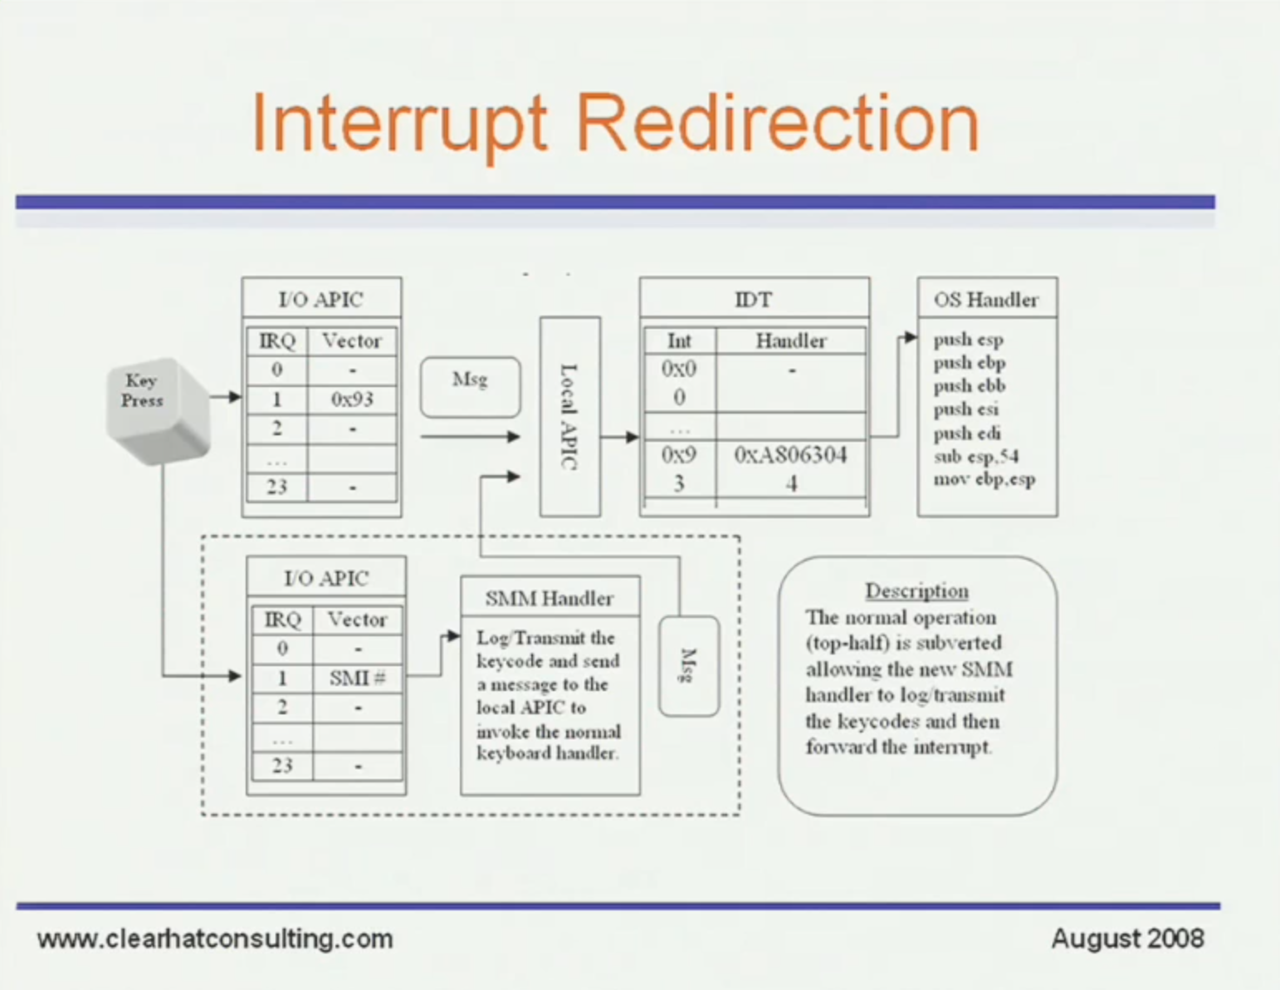
Means to implement legacy PS2 keylogging without having to modify anything in the OS

Slide 38
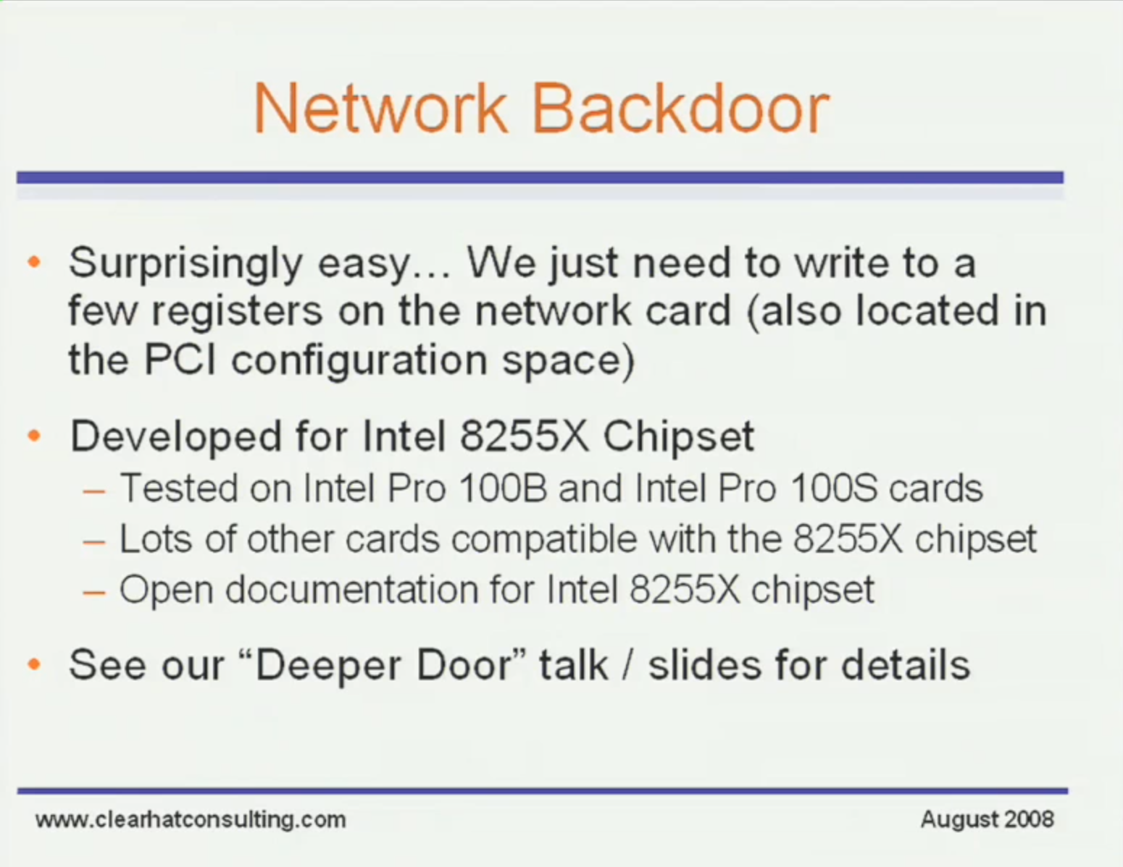

Slide 39

The Watcher
From https://www.blackhat.com/docs/us-14/materials/us-14-Kallenberg-Extreme-Privilege-Escalation-On-Windows8-UEFI-Systems.pdf

Slide 40
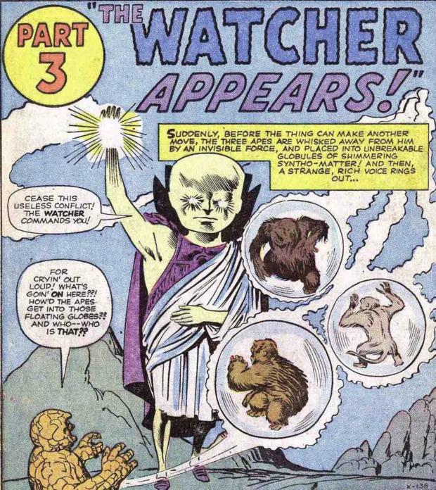
Presenting the first appearance of The Watcher!
Marvel Comics
Fantastic Four #13, 1963

Slide 41
The Watcher
The Watcher lives in SMM (where you can't look for him)
It has no build-in capability except to scan memory for a magic signature
If it finds the signature, it treats the data immediately after the signature as code to be executed
In this way the Watcher performs arbitrary code execution on behalf of some controller, and is completely OS independent
A controller is responsible for placing into memory payloads for The Watcher to find
These payloads can make their way into memory through any means
Could be sent in a network packet which is never even processed by the OS
Could be embedded somewhere as non-rendering data in a document
Could be generated on the fly by some malicious javascript that's pushed out through an advertisement network
Could be pulled down by a low-privilege normal-looking dropper
Use your imagination

Slide 42
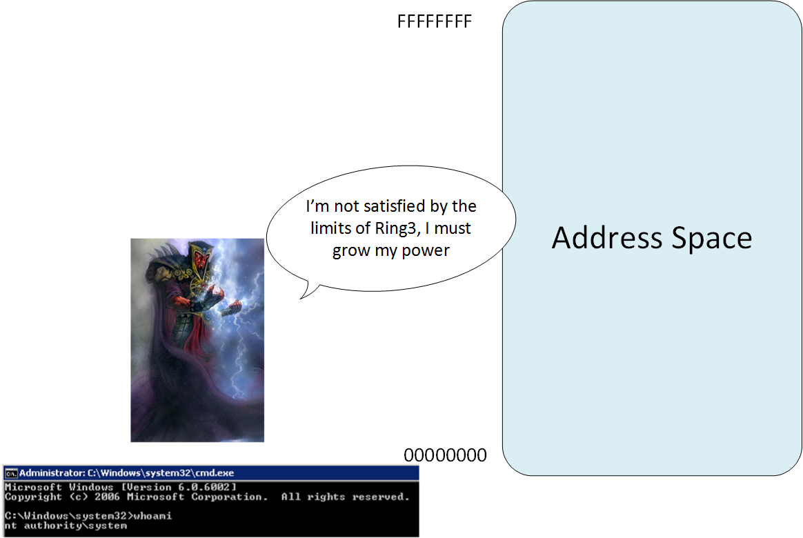
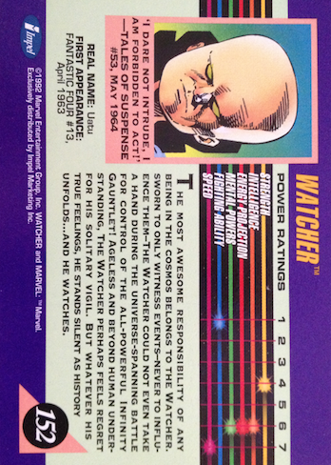
The Watcher, watching
RAM
0
Design tradeoffs:
We don't want to scan every 4 byte chunk of memory. So instead we scan every 0x1000-aligned page boundary.
How do we guarantee a payload will be found on a page-aligned boundary?
Another agent puts it there
Controller prefixes the payload with a full 0x1000 worth of signatures and pointers to the code to be executed (this guarantees a signature will always be found at the boundary or boundary+4)
There are obviously many different ways it could be built.
0x1000
0x2000
0x3000
. . .
0x2F7FE000
Web Page
…
Attached
(non-rendering) payload
Periodic continuous payload signature search all RAM
System Management
RAM (SMRAM)
Controller positions payload

Slide 43
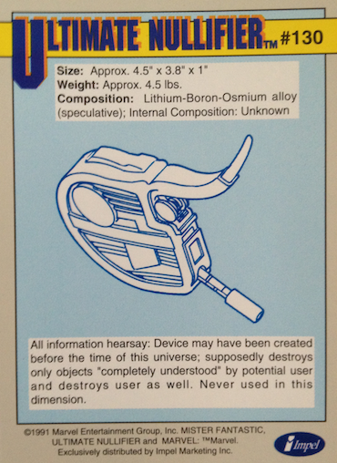
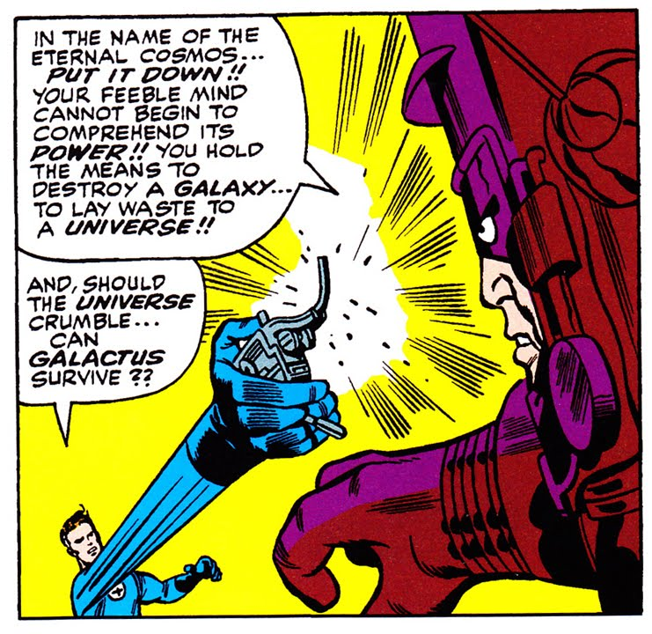

Demo
Marvel Comics
Fantastic Four #48, 1966
Impel 1991
Marvel Universe Series 2
Notes:
http://theblueseffect.files.wordpress.com/2008/11/ultimate-nul.jpg

Slide 44
Watcher Stats
A week to get dev env set up (I didn't have my SPI programmer) and to find where to insert the code into SMM so it got called on every SMI
2 days to write Watcher + basic print payload
Watcher itself: ~ 60 lines of mixed C and inline assembly
Print payload: 35 bytes + string, 12 instructions
Ultimate Nullifier payload: 37 bytes, 11 instructions
Overall point: very simple, very small, very powerful
How likely do you think it is that there aren't already Watchers watching?
But we can't know until people start integrity checking their BIOSes
Impel 1992
Marvel Universe Series 2

Slide 45
LightEater
Hello my friends.
Welcome to my home in the Deep Dark
From
http://legbacore.com/Research_files/HowManyMillionBIOSWouldYouLikeToInfect_Full2.pdf
Notes:
Voice track: We wanted to show that SMM attackers are the most privileged attackers, and are capable of doing all the attacks that lesser privileged attackers can do

Slide 46
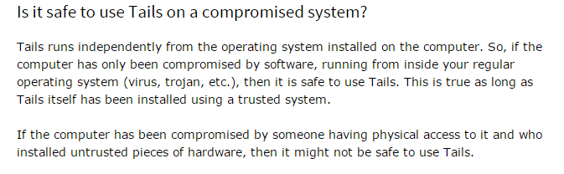
Time to rethink this…

Slide 47
LightEater on HP
For a change of pace, let’s see how easy evil-maid / border-guard / interdiction attacks are!
NIC-agnostic exfiltration of data via Intel Serial-Over-LAN
Option to “encrypt” data with bitwise rot13 to stop network defenders from creating a “Papa Legba” snort signature :P

Slide 48
LightEater on ASUS
Uses hook-and-hop from DXE IPL to SMM
From SMM attacks Windows 10
Gets woken up every time a process starts, prints information about the process

